Slide 1
Data Distributions

Slide 2
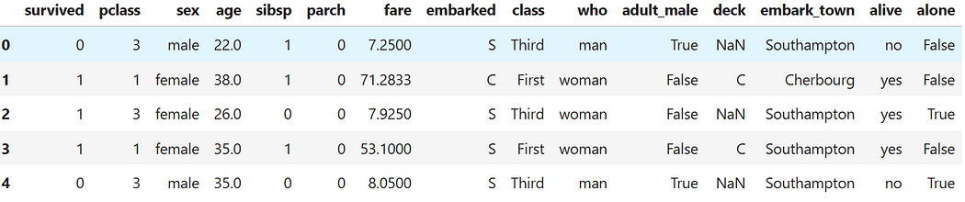
Data Distributions Dataset
‘titanic’ dataset in seaborn

Slide 3
Learning Objectives
By the end of this session, you will be able to:
Understand the concept of data distributions
Learn about skewness and kurtosis
Apply Python code for calculating skewness and kurtosis
Test your knowledge with quizzes and MCQs

Slide 4
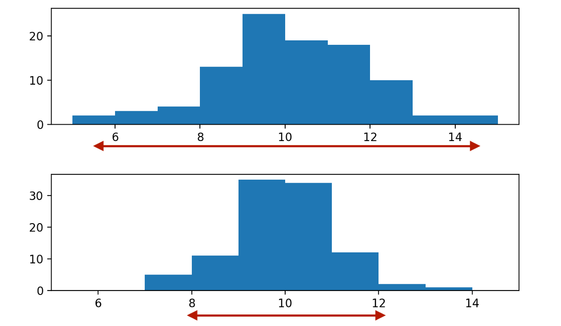
What is Spread?

Slide 5
What is a Data Distribution?
A data distribution describes how values in a dataset are spread.
Types of distributions: Symmetric vs. Skewed
Examples: Normal, Uniform, Binomial, Poisson
Helps in: Statistical modeling, Machine learning, Data-driven decision-making

Slide 6
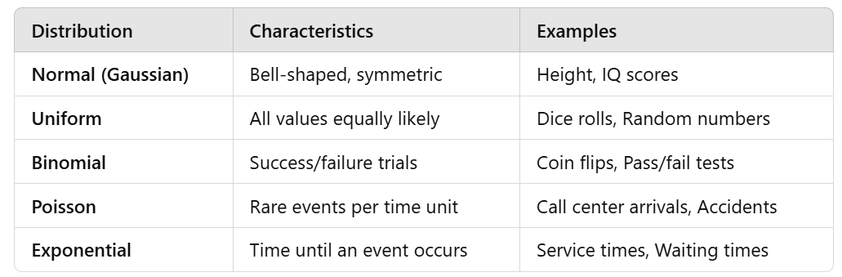
Types of Data Distributions

Slide 7
Real-World Applications of Distributions
Finance: Stock returns follow a normal/log-normal distribution
Healthcare: Disease spread follows a Poisson distribution
Retail: Customer arrivals follow an exponential distribution
Manufacturing: Quality control uses a binomial distribution

Slide 8
Normal Distribution - The Bell Curve
Symmetrical bell-shaped curve
Defined by mean (μ) and standard deviation (σ)
68-95-99.7 Rule:
- 68% within 1σ
- 95% within 2σ
- 99.7% within 3σ

Slide 9
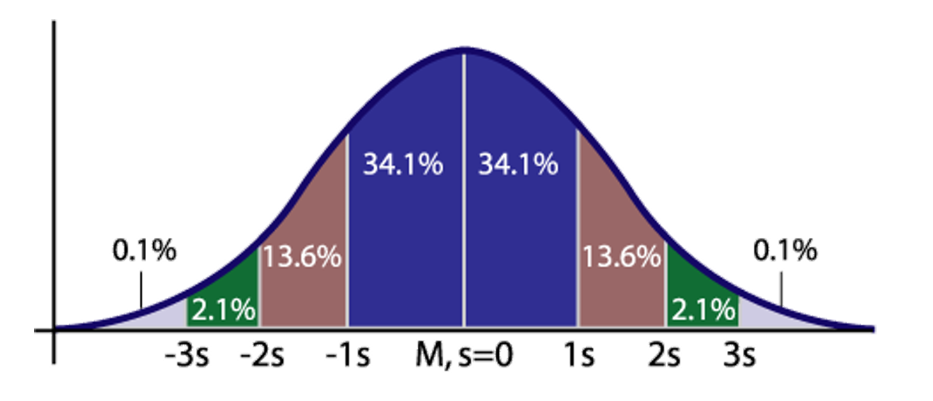
Normal Distribution - The Bell Curve

Slide 10
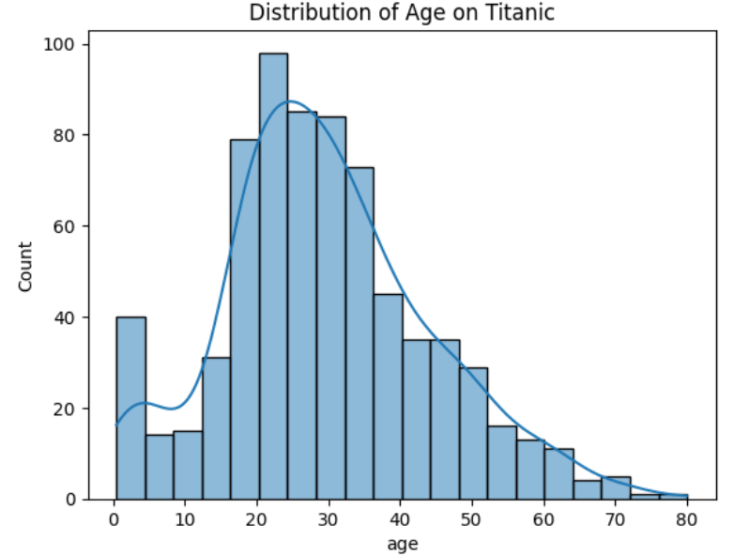
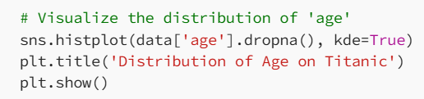
Visualizing Distribution

Slide 11
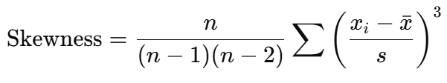
Skewness - Symmetry of Data
Skewness tells us whether our data is skewed left, right, or symmetrical.
Measures asymmetry of distribution
Formula:

Slide 12
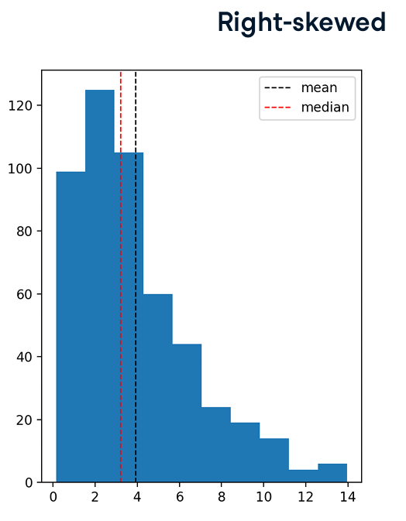
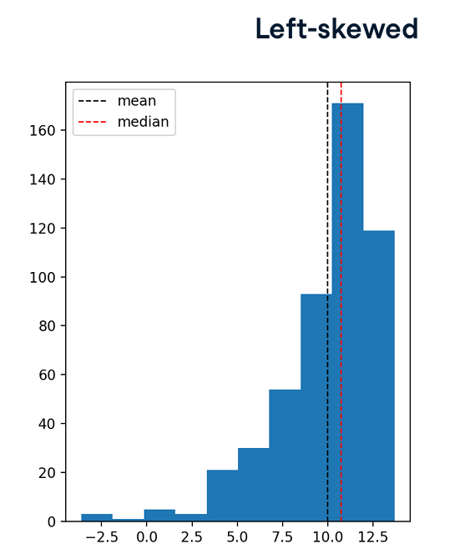
Skewness - Symmetry of Data
(Mean < Median)
(Mean > Median)

Slide 13
Skewness Example
Given a dataset: [150, 200, 250, 300, 350, 400, 800], compute the skewness.

Slide 14
Skewness Example
Given a dataset: [150, 200, 250, 300, 350, 400, 800], compute the skewness.
Is the data right or left skewed?

Slide 15
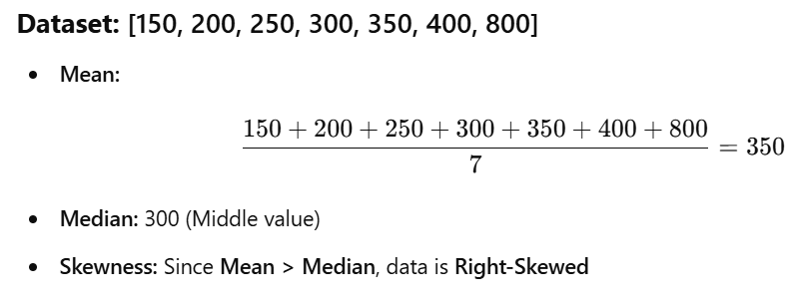
Skewness Example

Slide 16
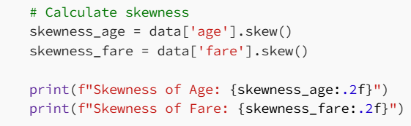

Skewness in Python
Explanation:
Positive skew (> 0): Tail extends to the right.
Negative skew (< 0): Tail extends to the left.
Zero skew: Perfectly symmetrical.
Output:
Age is slightly positively skewed (some older passengers create a right tail).
Fare is heavily positively skewed (some passengers paid extremely high fares).

Slide 17
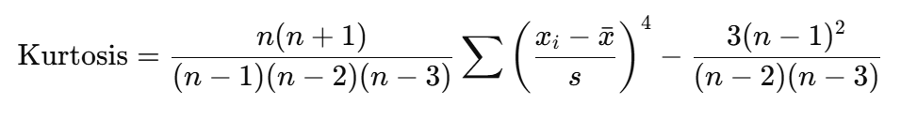
Kurtosis - Tails of the Distribution
Definition: Kurtosis measures whether data has heavy or light tails
Types of kurtosis:
Leptokurtic (High Kurtosis): Heavy tails (outliers). Kurtosis value > 3
Mesokurtic (Normal Kurtosis): Like a normal distribution. Kurtosis value = 3 approx
Platykurtic (Low Kurtosis): Light tails (less variation) Kurtosis value < 3
Formula:

Slide 18
Skewness vs Kurtosis
Skewness focusses on direction of outliers whereas kurtosis measures intensity of outliers.
A dataset can be symmetric (no skew) but still have high kurtosis (many outliers)

Slide 19
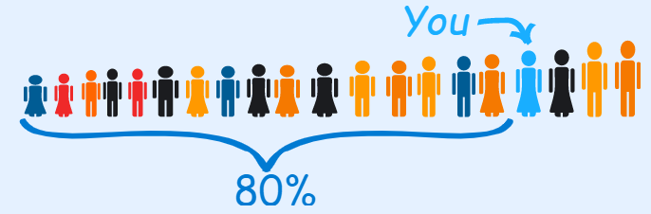
Measures of Dispersion (IQR)
Percentile: Percentiles indicate the percentage of scores that fall below a particular value.
Example: Suppose you are the fourth tallest person in a group of 20 people. So that means 16 people are shorter than you. 80% of the people are shorter than you. That means you are at the 80th percentile.
Formula for Percentile = (Number of Values Below “x” / Total Number of Values) × 100

Slide 20
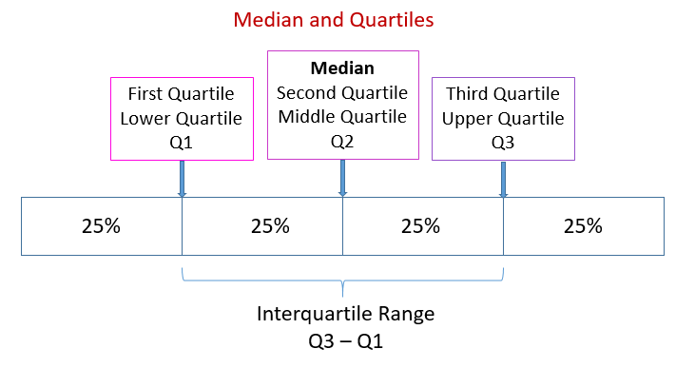
IQR (Interquartile range)
Quartiles: Quartiles are the values that divide a list of numbers into quarters.
Q1: Middle number between the smallest number and the median of the data set.
Q2: Median of the data set.
Q3: Middle value between the median and the highest value of the data set.
Inter Quartile Range (IQR) = Q3 – Q1

Slide 21
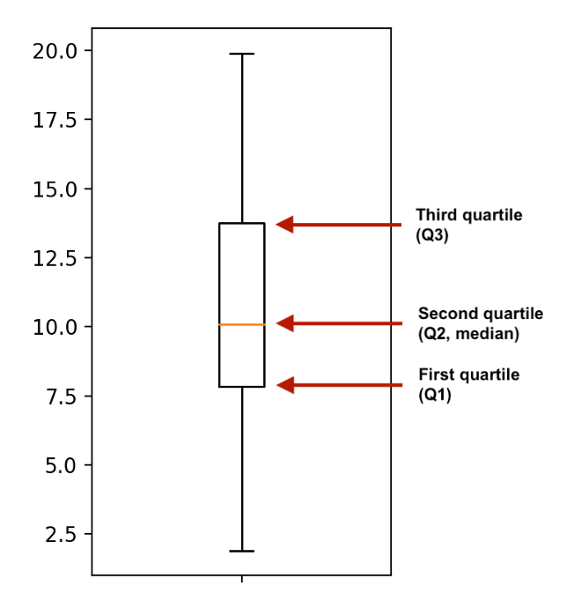
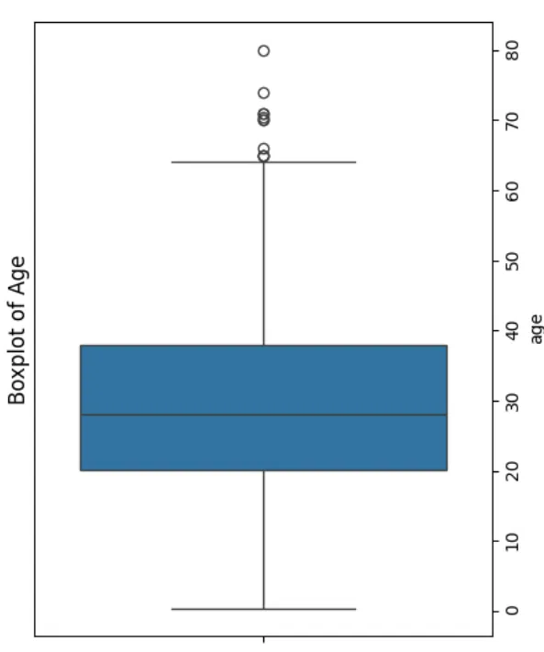
Boxplot Representation

Slide 22
Python Implementation
https://github.com/vikashkmd/DSMLNotebooks/blob/main/Data%20distribution%20skewness%20and%20kurtosis.ipynb
The Ultimate Guide to Data Distributions: Skewness, Centering, and Spread Made Simple

Slide 23
Multiple Choice Questions (MCQs)
Q1:What does a right-skewed distribution indicate?
A) The majority of values are low, with a few high values
B) The majority of values are high, with a few low values
C) The data is perfectly symmetrical
D) The data has no variation
Q2:Which measure is best for skewed data?
A) Mean
B) Median
C) Mode
D) Standard deviation

Slide 24
Multiple Choice Questions (MCQs)
Q1:What does a right-skewed distribution indicate?
A) The majority of values are low, with a few high values ✅
B) The majority of values are high, with a few low values
C) The data is perfectly symmetrical
D) The data has no variation
Q2:Which measure is best for skewed data?
A) Mean
B) Median ✅
C) Mode
D) Standard deviation

Slide 25
Q3 . What does a high positive kurtosis (leptokurtic distribution) indicate about a dataset?
A) The data has lighter tails and fewer extreme outliers than a normal distribution.
B) The distribution is skewed heavily to the right.
C) The data has heavy tails and a higher risk of extreme outliers.
D) The mean, median, and mode are all equal.

Slide 26
Q3 . What does a high positive kurtosis (leptokurtic distribution) indicate about a dataset?
A) The data has lighter tails and fewer extreme outliers than a normal distribution.
B) The distribution is skewed heavily to the right.
C) The data has heavy tails and a higher risk of extreme outliers.
D) The mean, median, and mode are all equal.
Answer C)

Slide 27
In a negatively skewed (left-skewed) distribution, which of the following relationships generally holds true?
A) Mean > Median > Mode
B) Mean < Median < Mode
C) Mean = Median = Mode
D) Median > Mean > Mode

Slide 28
In a negatively skewed (left-skewed) distribution, which of the following relationships generally holds true?
A) Mean > Median > Mode
B) Mean < Median < Mode
C) Mean = Median = Mode
D) Median > Mean > Mode
Answer B)

Slide 29
Q. How does Winsorizing handle extreme outliers in a dataset?
A) It completely deletes the outlier observations from the dataset.
B) It replaces extreme values with the nearest non-outlier percentile values (e.g., 5th or 95th percentile).
C) It transforms the entire dataset using a logarithmic scale.
D) It replaces all missing and extreme values with the dataset mean.

Slide 30
Q. How does Winsorizing handle extreme outliers in a dataset?
A) It completely deletes the outlier observations from the dataset.
B) It replaces extreme values with the nearest non-outlier percentile values (e.g., 5th or 95th percentile).
C) It transforms the entire dataset using a logarithmic scale.
D) It replaces all missing and extreme values with the dataset mean.
Answer B)

Slide 31
Q. How is the Interquartile Range (IQR) calculated, and why is it preferred over standard deviation for skewed data?
A) IQR = Q3 - Q1; it is robust to extreme outliers.
B) IQR = Q4 - Q1; it covers 100% of the dataset.
C) IQR = Q3 + Q1; it measures the total variance of the sample.
D) IQR = Mean - Median; it measures the symmetry of the data.

Slide 32
Q. How is the Interquartile Range (IQR) calculated, and why is it preferred over standard deviation for skewed data?
A) IQR = Q3 - Q1; it is robust to extreme outliers.
B) IQR = Q4 - Q1; it covers 100% of the dataset.
C) IQR = Q3 + Q1; it measures the total variance of the sample.
D) IQR = Mean - Median; it measures the symmetry of the data.
Answer A)

Slide 33
Fill in the blanks
1. ______ measures the asymmetry of a data distribution.
2. The ______ rule states that 95% of data falls within 2 standard deviations of the mean in a normal distribution.
3. If the tails of a distribution are heavier than normal, it is called ______ kurtosis.

Slide 34
Fill in the blanks
1. ______ measures the asymmetry of a data distribution. (Answer: Skewness)
2. The ______ rule states that 95% of data falls within 2 standard deviations of the mean in a normal distribution. (Answer: 68-95-99.7 Rule)
3. If the tails of a distribution are heavier than normal, it is called ______ kurtosis. (Answer: Leptokurtic)

Slide 35
Session Summary
In this session, we have discussed about:
Understand the concept of data distributions
Learn about skewness and kurtosis
Explore measures of central tendency
Apply Python code for calculating skewness and kurtosis
Test your knowledge with quizzes and MCQs

Slide 36
Reference Links
Python notebook
The Ultimate Guide to Data Distributions: Skewness, Centering, and Spread Made Simple
How to Create Stunning Data Visualizations in Python: Top 10 Techniques to Learn
Mastering Credit Risk Analysis: A Step-by-Step Guide to Descriptive Statistics in Python
Phases of data science and analytics.

